Slide 1




WEB PAGES DESIGN
Organizing a Page’s Content with Lists, Figures, and Various Organizational Elements
Lecturer: Dr. Atheer Akram AbdulRazzaq
Lecture 6.
Class 2.
Time: 11:30 - 1:30
Department: Businesses Information Technology (BIT)

Slide 2
Outline
Outline
Unordered Lists
Descendant Selectors
Ordered Lists
Figures
Organizational Elements
section, article, and aside Elements
nav and a Elements
header and footer Elements
Child Selectors
CSS Inheritance
Summary

Slide 3
Outline
Unordered Lists
We start this lecture by learning how to implement lists. Let’s jump right into an example. In example bellow we note the unordered list that shows my weekday routine.
It’s called “unordered” because the list items have bullets and circles next to them, and bullets and circles do not imply any order.
To create an unordered list, you surround the entire list with a ul container (ul for unordered list) and use li containers for the individual list items. Here’s an example:
<ul>
<li>Wake up at 9ish.</li>
<li>Go to school.</li>
</ul>
Note that it is legal to omit the </li> end tag for list elements, so this is valid HTML as well:
<ul>
<li>Wake up at 9ish.
<li>Go to school.
</ul>
However, in the interest of readability and maintenance, coding conventions suggest that you do not omit the </li> end tag.

Slide 4
Outline
Unordered Lists(continue…)
Parent and Child Elements
Let’s now examine the complete source code for the Work Day web page in the example 1. The ul container is considered to be a parent element for the three li containers, and the three li containers are considered to be child elements of the ul container.
The parent–child relationship exists between two elements when the parent element’s start tag and end tag surround the child element and there are no other container elements inside the parent element that surround the child element. By examining the Work Day web page’s source code, you should be able to verify that the outermost ul container and the three boxed li containers match that description.
Example 1. (Work Day web page)
<!DOCTYPE html>
<html lang="en">
<head>
<meta charset="utf-8">
<meta name="author" content="AAA">
<title>Typical Work Day</title>
</head>
<body>
<h1> Typical Work Day</h1>

Slide 5
Outline
Unordered Lists(continue…)
Parent and Child Elements
Example 1. (continue…)
<ul>
<li> Morning
<ul>
<li>Wake up at 9ish.</li>
<li>Go to school.</li>
</ul>
</li>
<li> Afternoon
<ul>
<li>Lecture period -not much prepared, so allow students to work on their homework during hands-on time in the lab.</li>
<li>Go home and watch TV.</li>
</ul>
</li>
<li> Evening </li>
</ul>
</body>
</html>
The big ul container has three child li containers.

Slide 6
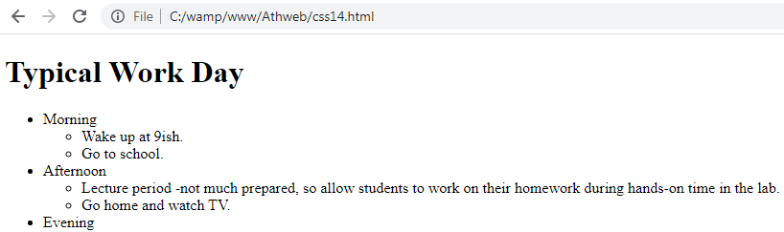
Outline
Unordered Lists(continue…)
Parent and Child Elements
Example 1. (continue…)
Output:
Symbols for Unordered List Items
According to the W3C, the default symbol for unordered list items is a bullet for all levels in a nested list, but the major browsers typically use bullet, circle, and square symbols for the different levels in a nested list.
Because the official symbol defaults and the browser symbol defaults are different, you should avoid relying on them. Instead, you should use CSS’s list-style-type property to explicitly specify symbols used in your web page lists.

Slide 7
Outline
Unordered Lists(continue…)
Symbols for Unordered List Items( continue…)
For unordered lists, the most popular values for the list-style-type property are none, disc, circle, and square.
In the example 2. the second-version Work Day web page, here’s the style container that generates the list’s circle and square symbols:
<style>
ul {list-style-type: circle;}
ul ul {list-style-type: square;}
</style>
Example 2. (the second-version Work Day web page)
<!DOCTYPE html>
<html lang="en">
<head>
<meta charset="utf-8">
<meta name="author" content="AAA">
<title>Typical Work Day</title>
<style>
ul {list-style-type: circle;}
ul ul {list-style-type: square;}
</style>
</head>
<body>
<h1> Typical Work Day</h1>

Slide 8
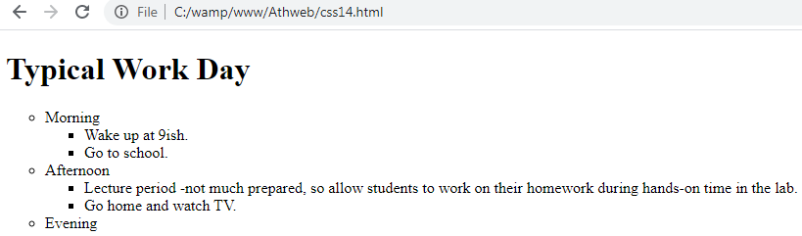
Outline
Unordered Lists(continue…)
Symbols for Unordered List Items( continue…)
Example 2. (continue…)
<ul>
<li>Morning</li>
<ul>
<li>Wake up at 9ish.</li>
<li>Go to school.</li>
</ul>
<li> Afternoon</li>
<ul>
<li>Lecture period -not much prepared, so allow students to work on their homework during hands-on time in the lab.</li>
<li>Go home and watch TV.</li>
</ul>
<li> Evening </li>
</ul>
</body>
</html>
Output:

Slide 9
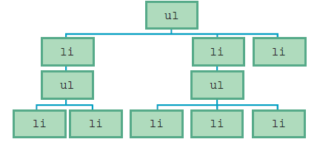
Outline
Descendant Selectors
A descendant selector is when we specify a series of two or more selectors separated by spaces. For each pair of adjacent selectors, the browser searches for a pair of elements that match the selectors such that the second element is contained within the first element’s start tag and end tag.
When an element is inside another element’s start tag and end tag, we say that the element is a descendant of the outer element.
To better understand the descendant selector, let’s look at an figure 1. The following structure shows how the Work Day web page’s ul and li elements are related:
Figure 1. The structure of the Work Day web page’s ul and li elements

Slide 10
Outline
Descendant Selectors (continue…)
The ul element at the top is for the outer list. The three li elements below it are for the morning, afternoon, and evening list items.
Each of the first two list elements contains a sublist, built with its own ul and li elements. The descendant relationship between two elements mimics the descendant relationships you can find in a family tree.
Here’s the syntax for a descendant selector rule:
space-separated-list-of-elements {property1: value; property2: value;}
In the following style container, note how the second and third rules use that syntax:
<style>
ul {list-style-type: disc;}
ul ul {list-style-type: square;}
ul ul ul {list-style-type: none;}
</style>
In applying the three preceding rules to a web page, the browser would use the first rule to generate bullet symbols for list items at the outer level of an unordered outline. It would use the second rule to generate square symbols for list items at the first level of nesting within an unordered outline. And it would use the third rule to display no symbols for list items at the next level of nesting within an unordered outline.

Slide 11
Outline
Ordered Lists
We’ll learn how to generate list items that have numbers and letters next to them. Numbers and letters indicate that the order of the list items is important, and that changing the order would change the list’s meaning. Those types of lists are referred to as ordered lists.
To create an ordered list, you surround the entire list with an ol container (ol for ordered list). As with unordered lists, you use li containers for the individual list items and you should indent the li containers within the ol container, for example:
<ol>
<li>Personal experiences</li>
<li>What friends say</li>
</ol>
To create sublists for an ordered list, use the same technique that you learned earlier for unordered lists—within the outer list’s ol container, insert an li container, and in that li container, insert an ol container with its own list items, as shown in example 3.
Example 3.
<!DOCTYPE html>
<html lang="en">
<head>
<meta charset="utf-8">
<meta name= "author" content=“AAA">

Slide 12
Outline
Ordered Lists (continue…)
Example 3. (continue…)
<title>Research Paper Template</title>
<style>
ol {list-style-type: upper-roman;}
ol ol {list-style-type: upper-alpha;}
ol ol ol {list-style-type: decimal;}
</style>
</head>
<body>
<h3>Research Paper Template</h3>
<ol>
<li>Introduction</li>
<li>
Main body
<ol>
<li>Ice-breaker cartoons</li>
<li>
Examples
<ol>
<li>Personal experiences</li>
<li>What friends say</li>

Slide 13
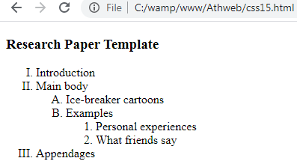
Outline
Ordered Lists (continue…)
Example 3. (continue…)
</ol>
</li>
</ol>
</li>
<li>Appendages</li>
</ol>
</body>
</html>
Output:
There are lots of list-style-type property values for ordered lists. Some of the more popular values are decimal, upper-alpha, lower-alpha, upper-roman, and lower-roman.

Slide 14
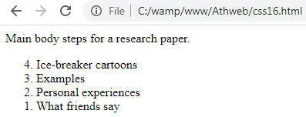
Outline
Ordered Lists (continue…)
We should be aware of the ol element’s reversed and start attributes. As its name implies, the reversed attribute causes list item labels to be in reverse order. For example, the following example get displayed with the labels 4, 3, 2, and 1:
Example 4:
<body>
Main body steps for a research paper.
<ol reversed>
<li>Ice-breaker cartoons</li>
<li>Examples</li>
<li>Personal experiences</li>
<li>What friends say</li>
</ol>
</body>
Output:

Slide 15
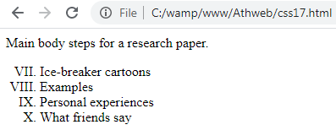
Outline
Ordered Lists (continue…)
The start attribute causes list item labels to start at a specified position. So in the example 5., the ol element’s start=“7" means that the first list item displays a label associated with the 7th position.
The style container’s .roman-list rule specifies uppercase roman numerals for the list items. Therefore, the four list items get displayed with the labels VII, VIII, IX, and X (which are the roman numerals for 7, 8, 9, and 10).
Example 5.
<style>
.roman-list {list-style-type: upper-roman;}
</style>
<body>
Main body steps for a research paper.
<ol class="roman-list" start="7">
<li>Ice-breaker cartoons</li>
<li>Examples</li>
<li>Personal experiences</li>
<li>What friends say</li>
</ol>
</body>
Output:

Slide 16
Outline
Figures
We’ll learn how to implement a figure. Typically, a figure holds text, programming code, an illustration, a picture, or a data table. As with all figures, the figure element’s content should be self-contained, and it should be referenced from elsewhere in the web page.
Figure with a Code Fragment
In example 6., the figure element use to display a listing of programming code that’s offset from the regular flow of the web page.
Note. the figure element’s start tag and end tag. Also, note the figcaption element inside the figure container. As its name implies, the figcaption element causes the browser to display a caption for a figure.
Note. To make the border visible with a reddish color and a reasonable amount of padding inside it, it was necessary to add this CSS rule:
figure
{
border: solid crimson;
padding: 6px;
}

Slide 17
Outline
Figures (continue…)
Example 6.
<!DOCTYPE html>
<html lang="en">
<head>
<meta charset="utf-8">
<meta name="author" content="AAA">
<title>Code Fragment Figure</title>
<style>
figure {
border: solid crimson;
padding: 6px;
}
</style>
</head>
<body>
<p>
Listing 8.3 shows JavaScript code that repeatedly generates a pop-up
that tells the user to provide his/her credit card information.
</p>

Slide 18
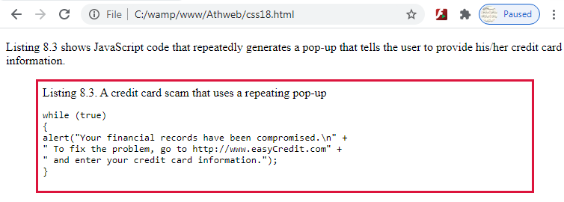
Outline
Figures (continue…)
Example 6. (continue…)
<figure>
<figcaption>Listing 8.3. A credit card scam that uses a repeating pop-up</figcaption>
<pre><code>while (true)
{
alert("Your financial records have been compromised.\n" +
" To fix the problem, go to http://www.easyCredit.com" +
" and enter your credit card information.");
}</code></pre>
</figure>
</body>
</html>
Output:
If you have a figcaption element,
it must be inside a figure element.

Slide 19
Outline
Figures (continue…)
Figure with an Image
The code is the same as for the Code Fragment Figure web page, except that the figcaption element is at the bottom of the figure container instead of at the top. Consequently, in the browser window, you can see that the caption displays below the picture.
To display a picture, you’ll need to use the img element. Here’s the relevant source code:
<img src="forest-trees1.jpg" alt="Waterfall in forest trees" width="400" height="400">
Note. the img element’s src attribute—that’s how you specify the location and name of an image file. In the preceding code fragment, note the img element’s alt attribute.
The HTML5 standard requires that for every img element, you provide an alt (for alternative) attribute. The alt attribute’s value should normally be a description of the picture.
Example 7.
<!DOCTYPE html>
<html lang="en">
<head>
<meta charset="utf-8">
<meta name="author" content=“AAA">

Slide 20
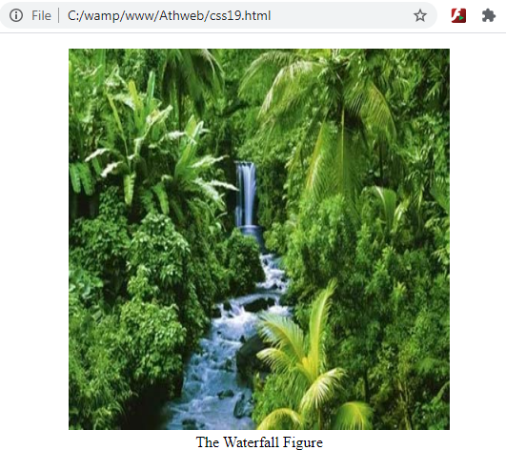
Outline
Figures (continue…)
Example 7. (continue…)
<title>Waterfall Figure</title>
<style>
body {text-align: center;}
</style>
</head>
<body>
<figure>
<!-- img element… src attribute… alt attribute -->
<img src="forest-trees1.jpg" alt="Waterfall in forest trees" width="400" height="400">
<figcaption>The Waterfall Figure</figcaption>
</figure>
</body>
</html>
Output:

Slide 21
Outline
Organizational Elements
In this section we’ll explained the organizational elements that don’t have obvious physical manifestations. Their purpose is to group web page content into sections so that you can use CSS and JavaScript to manipulate their content more effectively. Here are the organizational elements we’ll be introduced to:
Section , article, aside, nav, header, footer
There’s usually no need to use these organizational elements for small web pages, but when you have a multipage website, you should try to use them consistently.
In Example 8A and 8B. It showcases Mangie’s List, a service that features reviews of dining and clothing venues.
You can see two headings at the top with a light blue background color. The headings are surrounded by a header container.
Below the headings you can see two links that are surrounded by a nav (stands for navigation) container.
Then comes dining content and clothing content, each with its own section container. At the right, you can see a red box, which is implemented with an aside container.
Finally, at the bottom, you can see content enclosed in a footer container.

Slide 22
Outline
Organizational Elements (continue…)
Example 8A.
<!DOCTYPE html>
<html lang="en">
<head>
<meta charset="utf-8">
<meta name= "author" content="AAA">
<title>Mangie's List</title>
<style>
body {background-color: lightyellow;}
header {background-color: powderblue;}
section > h2 {background-color: palegreen;}
aside > h3 {margin: 0;}
aside {
border: thin dashed red;
color: red;
background-color: white;
float: right;
width: 200px;
margin: 5px;
padding: 10px;
}
address {display: inline;}
</style>
</head>
Child selectors
Use the float property to position an element at the left or right edge of its surrounding container.
Use the width, margin, and padding properties to make the aside box look good.
display property

Slide 23
Outline
section, article, and aside Elements
In this section, we describe three of the organizational elements—section, article, and aside. Typically, a section will contain a heading and one or more paragraphs, with the heading saying something about the common theme.
For example, if you use a section element for a chapter, you would use a heading element for the chapter’s title.
The article element is for grouping together one or more sections such that the group of sections form an independent part of a web page. In the example 8B., the article container, which surrounds the web page’s two sections. There’s just one article because the sections are related.
The aside element. Its purpose is to group together content that has something to do with the rest of the web page, but it isn’t part of the main flow. Typically, you should position an aside element at the right or left.
On the Mangie’s List web page, note the red box. It contains advertising text, which is not part of the web page’s main content, and it’s positioned at the right side of the first section.

Slide 24
section, article, and aside Elements (continue…)
Outline
The following CSS rule is for the aside element in the Mangie’s List web page. In particular, note the float: right; property-value pair:
aside {
border: thin dashed red;
color: red;
background-color: white;
float: right;
width: 200px;
margin: 5px;
padding: 10px;
}
Example 8B.
<body>
<header> <!--header elements-->
<h1>Mangie's List</h1>
<h2><q>Simply the best reviews anywhere!</q></h2>
</header>
<nav> <!--nav elements-->
<!--a elements-->
<a href="#dining">Dining</a> | <a href="#clothing">Clothing</a>
</nav>

Slide 25
section, article, and aside Elements (continue…)
Outline
Example 8B. (continue…)
<article> <!--article elements-->
<section> <!--section elements-->
<aside> <!--aside elements-->
<h3>Casey's Special</h3>
Half-price hot dogs when rotisseried more than 24 hours!
</aside>
<h2 id="dining">Dining</h2>
<ol>
<li>China Star</li>
<li>Casey's General Store</li>
</ol>
</section>
<section> <!--section elements-->
<h2 id="clothing">Clothing</h2>
<ol>
<li>Eddie Bauer</li>
<li>Kansas Speedway Boutique</li>
<li>Casey's General Store</li>
</ol>
</section>
</article>

Slide 26
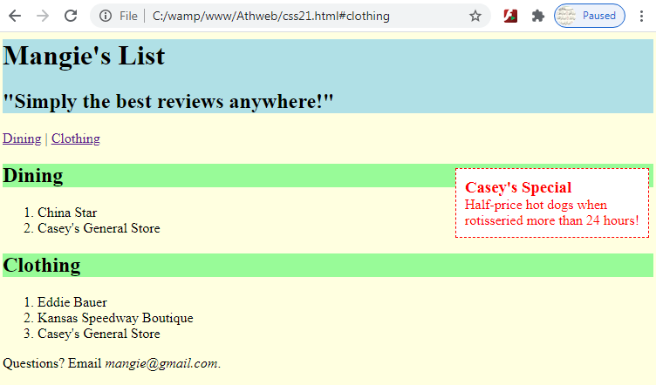
section, article, and aside Elements (continue…)
Outline
Example 8B. (continue…)
<footer> <!--footer elements-->
<!--address elements-->
Questions? Email<address>mangie@gmail.com</address>
</footer>
</body>
</html>
Output:

Slide 27
nav and a Elements
Outline
In this section, we describe another organizational element—nav. The nav element is a container that normally contains links to other web pages or to other parts of the current web page. The nav element gets its name from navigate because you use links to navigate to (jump to) other locations.
note in the Example 8., the two purple links near the top of the web page labeled “Dining” and “Clothing.” Here’s the nav code that contains those links:
<nav>
<a href="#dining">Dining</a> | <a href="#clothing">Clothing</a>
</nav>
Note the two a elements, each with its own pair of start and end tags. Each a element implements a link. When the user clicks on a link, the browser jumps to the value specified by the href attribute.
In example 8., we can see the heading code for the web page’s dining section:
<h2 id="dining">Dining</h2>
So with an id value of “dining,” that heading serves as a target when the user clicks on the nav container’s first link.

Slide 28
header and footer Elements
Outline
In this section, we cover two more—header and footer.
header Element
The header element is for grouping together one or more heading elements (h1-h6) such that the group of heading elements form a unified header for nearby content. Normally, the header is associated with a section, an article, or the entire web page.
For the Mangie’s List web page, we use a header element to group together an h1 title and an h2 quote above all of the other content.
Here’s the code for the CSS rule and for the header container:
<style>
header {background-color: powderblue;}
...
</style>
<header>
<h1>Mangie's List</h1>
<h2><q>Simply the best reviews anywhere!</q></h2>
</header>
As an alternative, we could have used this CSS rule:
h1, h2 {background-color: powderblue;}
footer Element (with address Element Inside It)
The footer element is for grouping together information to form a footer. Typically, the footer holds content such as copyright data, author information, or related links. The footer should be associated with a section, an article, or the entire web page.

Slide 29
header and footer Elements (continue…)
Outline
footer Element (with address Element Inside It) (continue…)
For the Mangie’s List web page, we use a footer element for contact information. Here’s the relevant code:
<footer>
Questions? Email <address>mangie@gmail.com</address>.
</footer>
Note how the footer container has an address element inside of it. The address element is for contact information. Here, we show an e-mail address, but the address element also works for phone numbers, postal addresses, article, and so on.
display Property, User Agent Style Sheets
The address element is a block element, so by default, browsers display it on a line by itself. But sometimes, you’re going to want to display an address in an inline manner within a sentence. If you look at the Mangie’s List web page, you can see that the address is embedded within the footer’s sentence. To implement that inline behavior, the web page uses this CSS rule:
address {display: inline;}

Slide 30
Child Selectors
Outline
In introducing child selectors, it’s helpful to compare them to descendant selectors. Remember how descendant selectors work? That’s when you have two selectors separated by a space, and the browser searches for a pair of elements that match the selectors such that the second element is a descendant of the first element.
Instead of allowing the second element to be any descendant of the first element, the second element must be a child of the first matched element (i.e., the second element must be within the first element, and there are no other container elements inside the first element that surround the second element).
The syntax for a child selector is the same as the syntax for a descendant selector, except that > symbols are used instead of spaces. Here’s the syntax:
list-of-elements-separated-with->’s {property1: value; property2: value;}
For an example, look at this CSS rule from the Mangie’s List web page:
section > h2 {background-color: palegreen;}
That rule matches each h2 element that is a child element of a section element. In the example 8B., the h2 elements inside the section containers. Those h2 elements say “Dining” and “Clothing.” Thus, the preceding CSS rule causes browsers to display those two words with pale green background colors.
The > symbol is called a “combinator” because it’s used to combine the element at its left with the element at its right.

Slide 31
CSS Inheritance
Outline
CSS inheritance is when a CSS property value flows down from a parent element to one or more of its child elements. That should sound familiar. It parallels the inheritance of genetic characteristics (e.g., height and eye color) from a biological parent to a child.
Some CSS properties are inheritable and some are not, here are the ones that are inheritable:
color
font (and all of its more granular properties, like font-size)
line-height
list-style (and all of its more granular properties, like list-style-type)
text-align
text-transform
To explain CSS inheritance, we’ll refer once again to the Mangie’s List web page. Specifically, we’ll refer to this aside element:
<aside>
<h3>Casey's Special</h3>
Half-price hot dogs when rotisseried more than 24 hours!
</aside>

Slide 32
CSS Inheritance (continue…)
Outline
Also, we’ll refer to this associated CSS rule:
aside {
border: thin dashed red;
color: red;
background-color: white;
float: right;
width: 200px;
padding: 10px;
margin: 5px;
}
In this rule, the only inheritable CSS property is color. If you specify a yellow for a body element’s color, all the elements inside the body container would inherit that color. That would cause the browser to use that color when displaying all the text within the web page. So for the Mangie’s List web page, the red color gets inherited by the h3 element that is a child of aside element.
If a parent element and its child element have two different CSS rules with the same property specified, then the child element’s property-value pair (and not the parent element’s property-value pair) gets applied to the child element.
Formally, we say that the child element’s property-value pair overrides the inherited property-value pair. So, for the Mangie’s List web page, if color: blue; was specified for the h3 element inside the aside element, then the browser would display blue text for the h3 element.

Slide 33
Outline
Summary
In this lecture we explained the unordered lists, and also clarified the CSS list-style-type property that used to define the style of the list item marker. and the most popular values for list-style-type property are none, disc, circle, and square.
Also we clarified a descendant selector meaning, when we specify a series of two or more selectors separated by spaces. For each pair of adjacent selectors, the browser searches for a pair of elements that match the selectors such that the second element is contained within the first element’s start tag and end tag.
We explained the ordered lists that generate list items that have numbers and letters next to them.
In this lecture we learned how implement a figure that specifies self-contained content, like text, programming code, an illustration, a picture, or a data table.
Also we explained the organizational elements that don’t have obvious physical manifestations and their purpose was to group web page content into sections so that we could use CSS and JavaScript to manipulate their content more effectively.
We described also in this lecture five of the organizational elements which are the section, article, aside, nav and a. also we explained briefly the purpose and usage for each one.
Also the lecture clarified the meaning and usage of footer and header elements.
This lecture described the css child selector that has two selectors separated by a > symbol. The first selector indicates the parent element and the second selector indicates the child element CSS will style.
Also we described in this lecture the CSS inheritance when a CSS property value flows down from a parent element to one or more of its child elements.

Slide 34


THANK YOU

